Slide 1
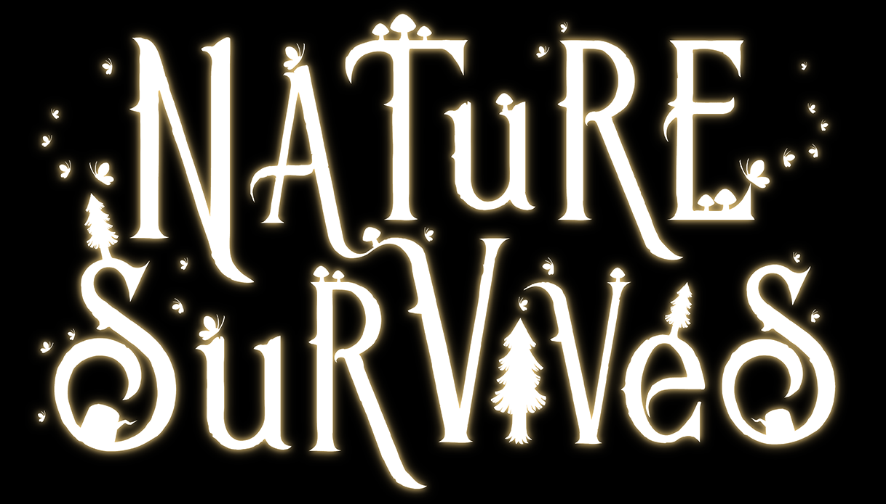
CREATIVE DESIGN DOCUMENT
Throwaway

Slide 2
Art Direction Overview
· Art Style
Low poly & Cartoonish style
The art style has a flavour of its own, but takes significant inspiration moving forwards from the Spyro: Reignited Trilogy. The cartoon style begins to favour more vibrant coloration across all the visual aspects of the game, without making the various creatures and buildings that inhabit it appear flat. Much like the new Spyro games, we are working to combine vibrant coloration with depth and an appealing sense of shape.
· Theme & Setting
In Nature Survives, we want to convey a world that is deeply stylized, yet accessible. A game that holds strong visual appeal through its vibrant colors and unique inhabitants, whilst effectively communicating information and enhancing the game experience.

Slide 3
Strengths
· Daytime Scene & Nighttime Scene
· Clear silhouettes
· Environment concept art · Art style is now very consistent
Weaknesses
· Communication · Co-ordination

Slide 4
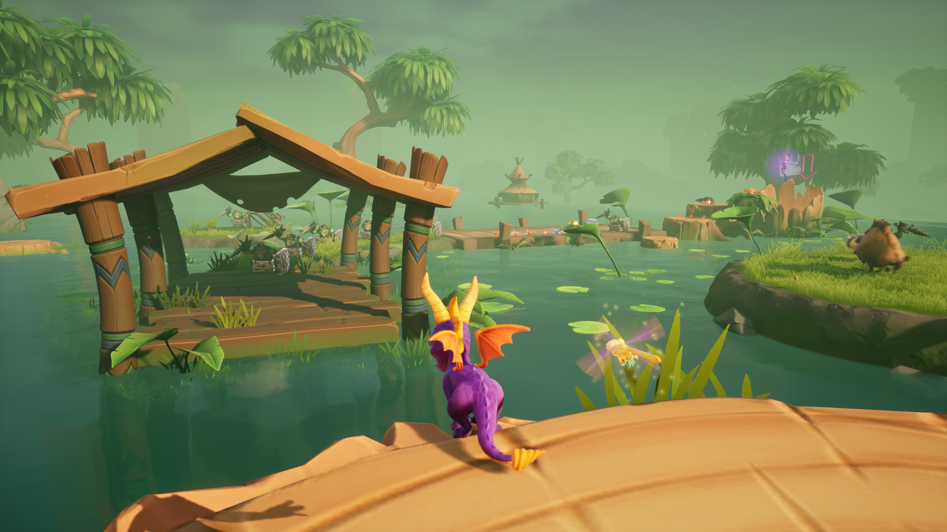
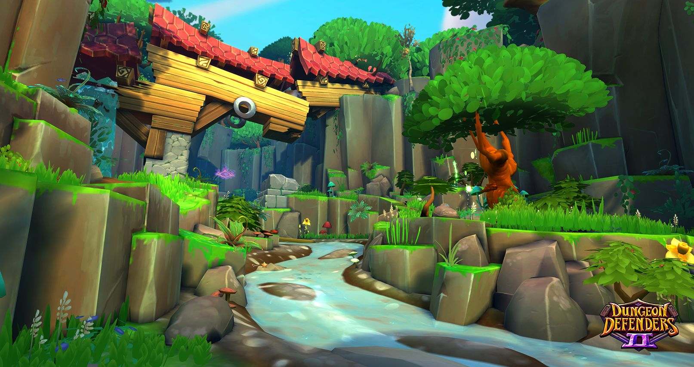
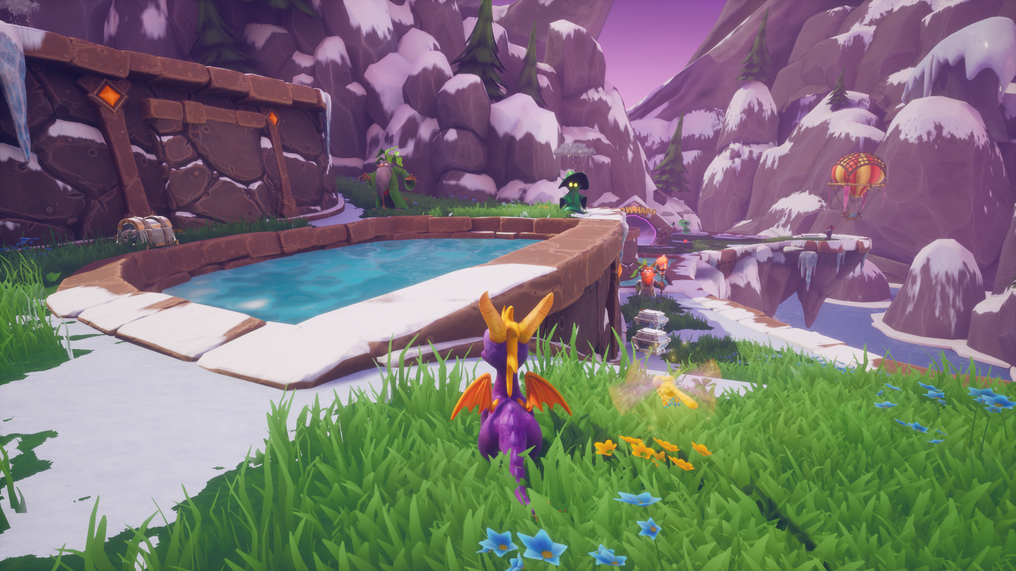
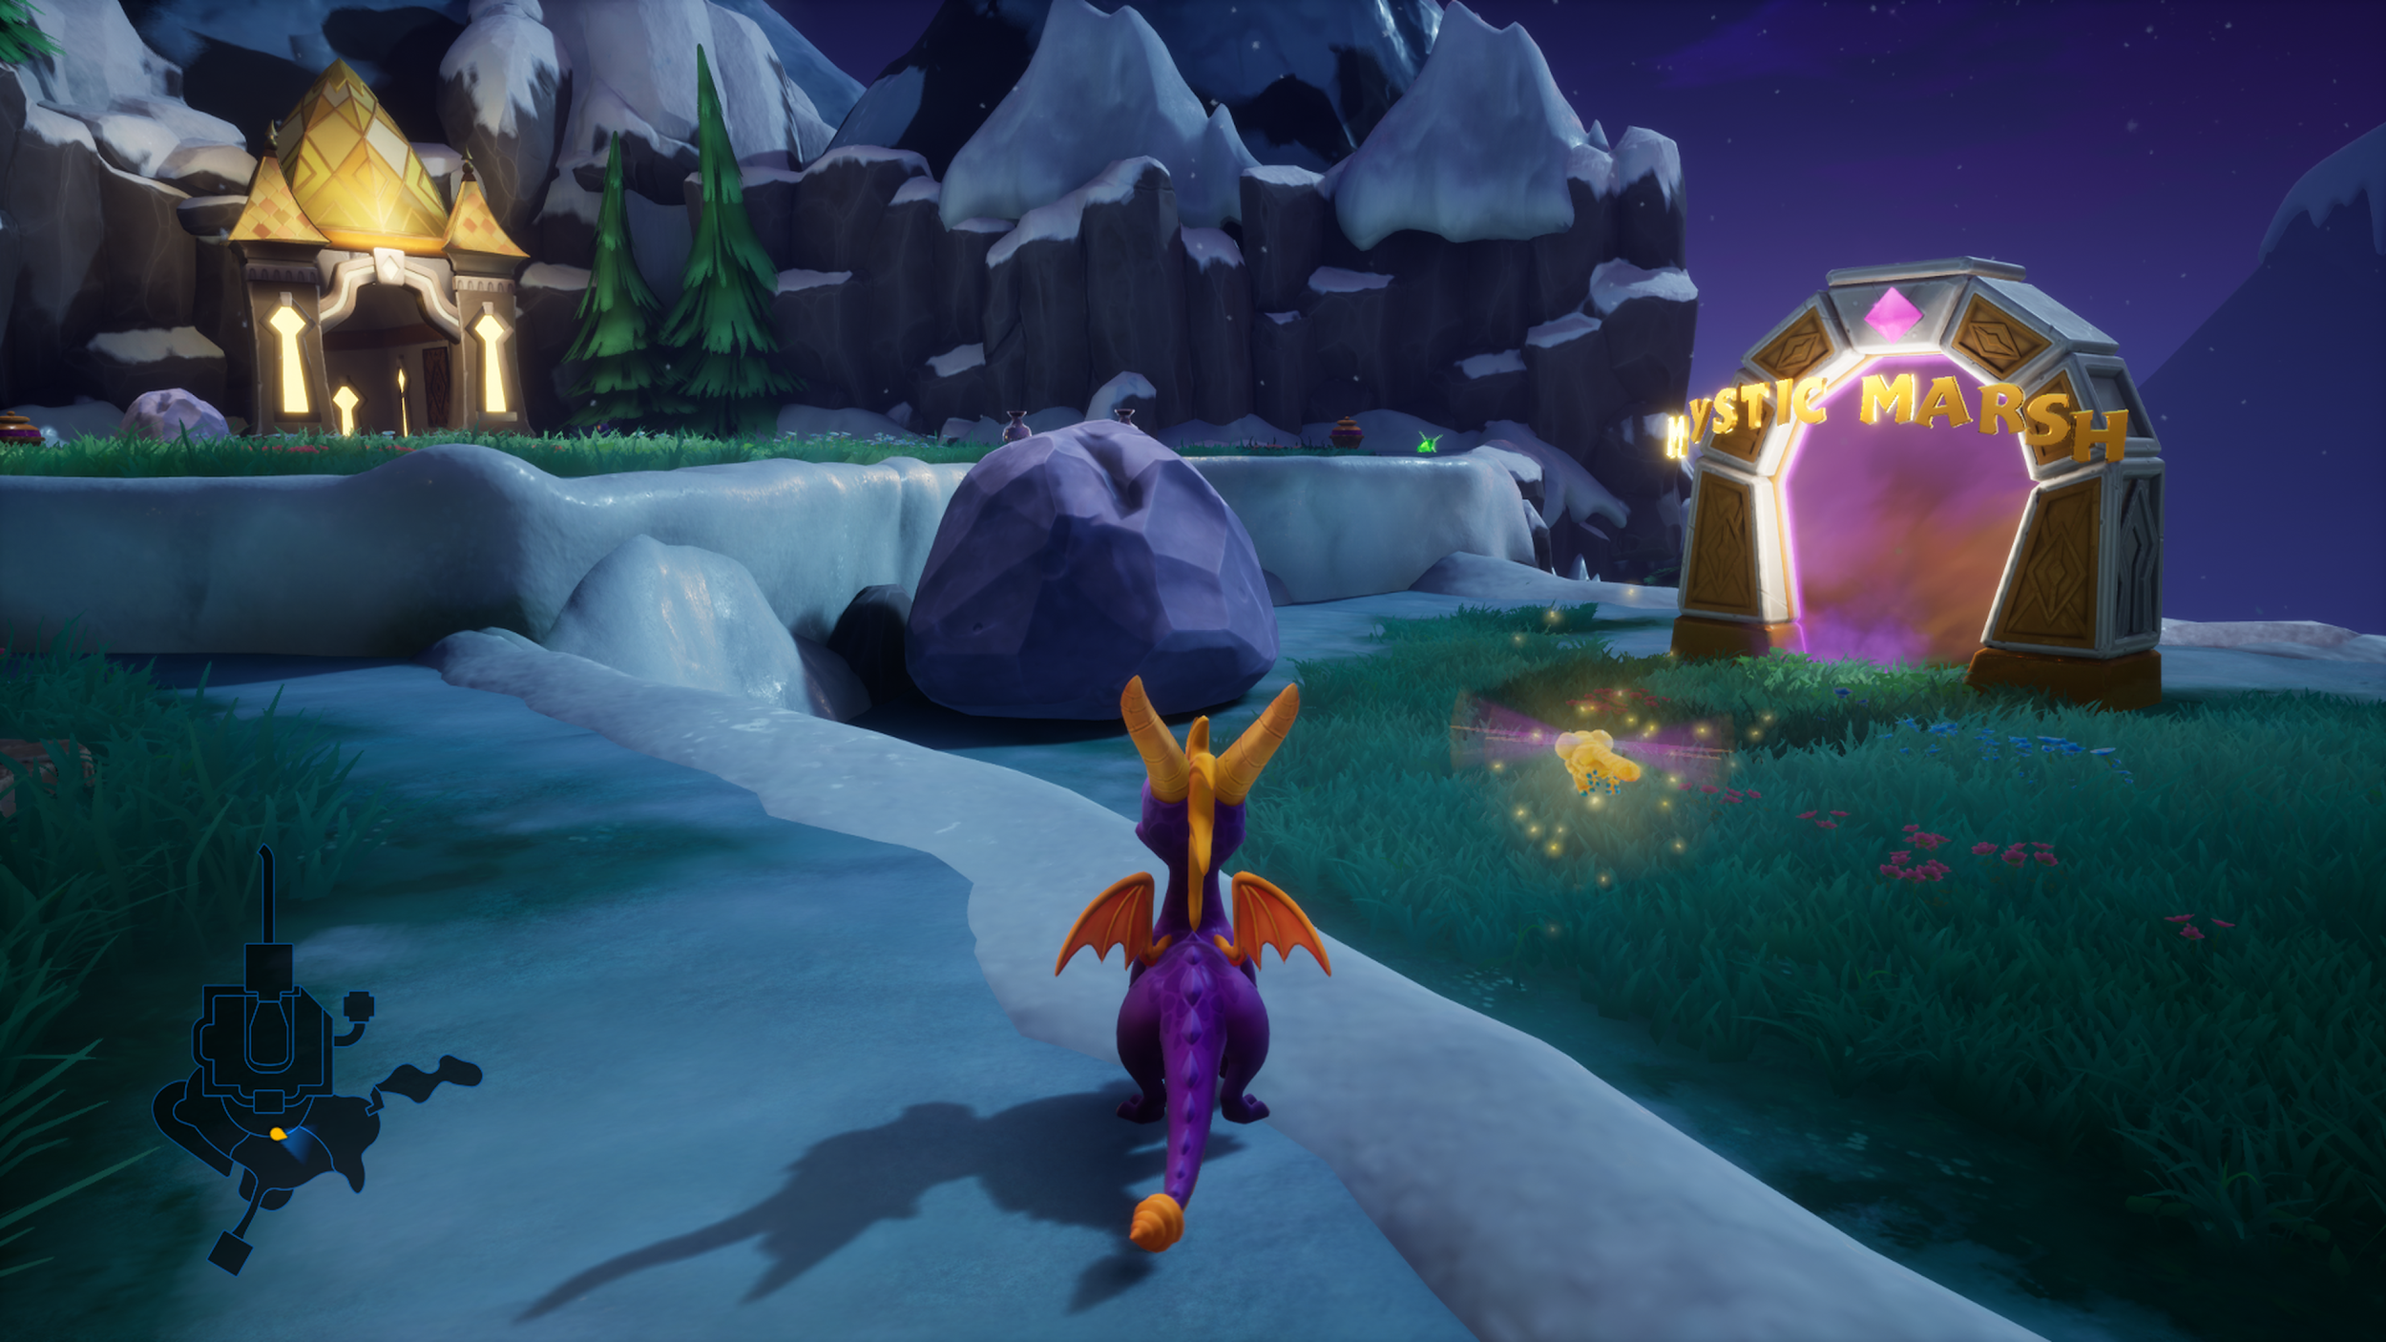
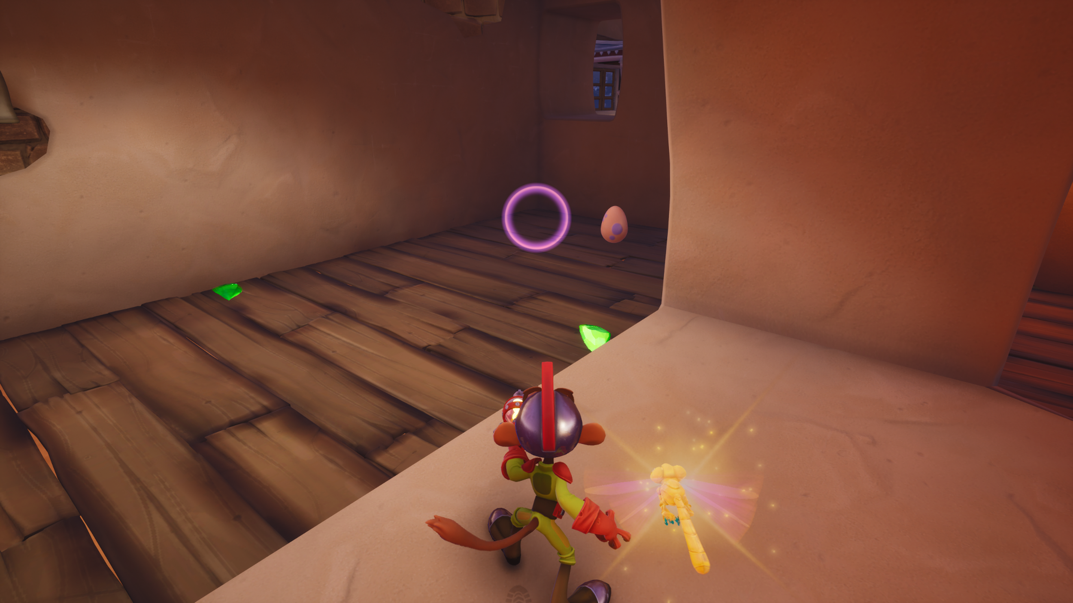
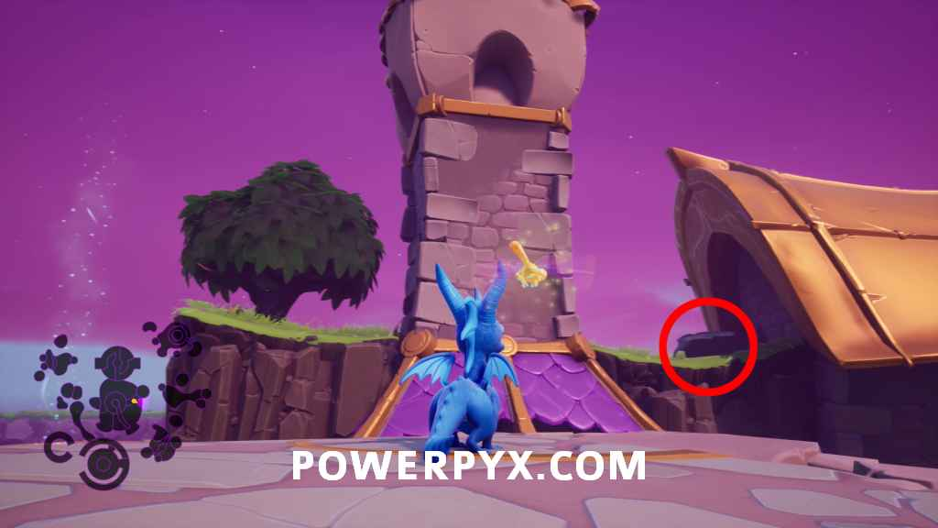
General Moodboard [Overall Feel of the game]

Slide 5
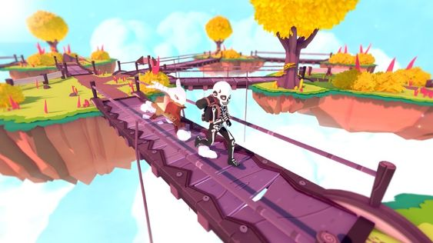
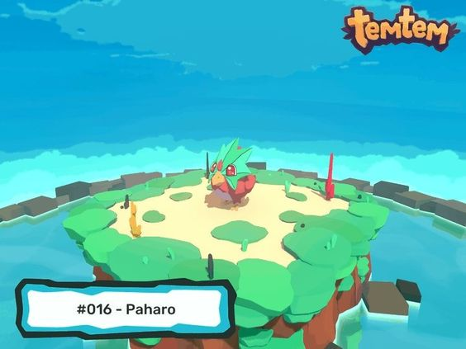
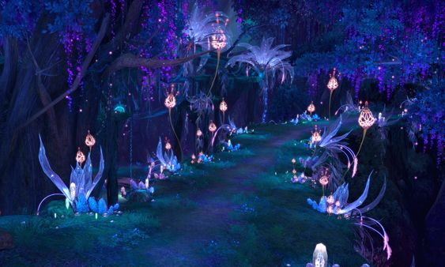
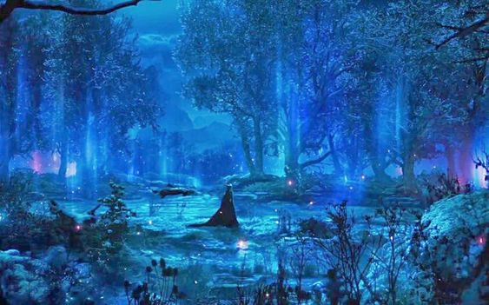
Environment Art Direction

Slide 6
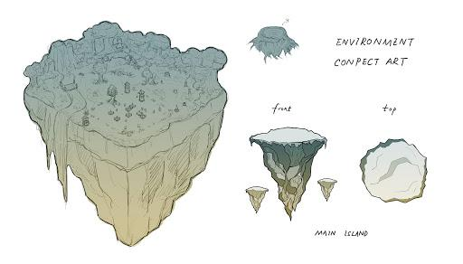
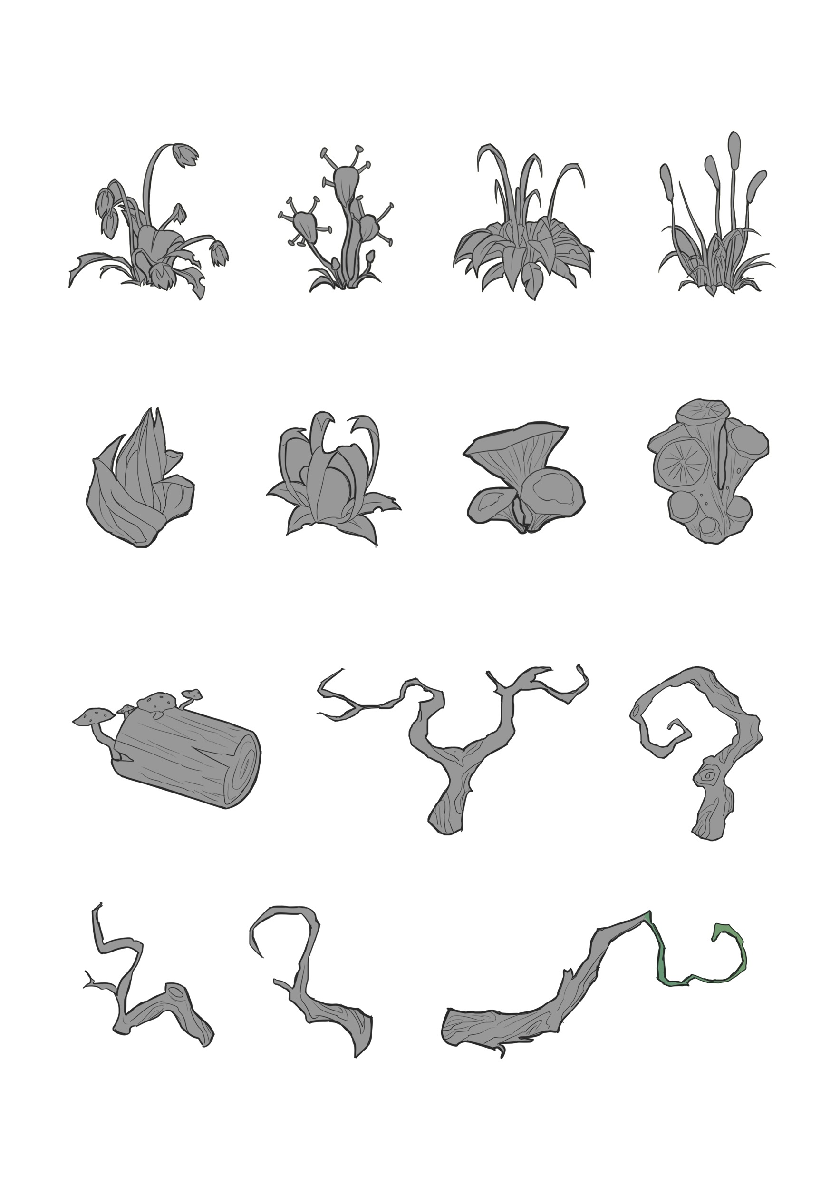
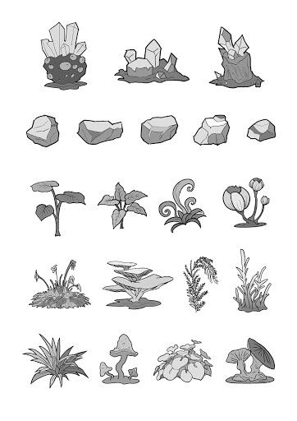
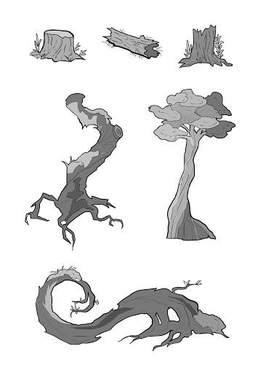
The Concept Art
· Floating Island
· New plants, rocks, trees
· New environment

Slide 7
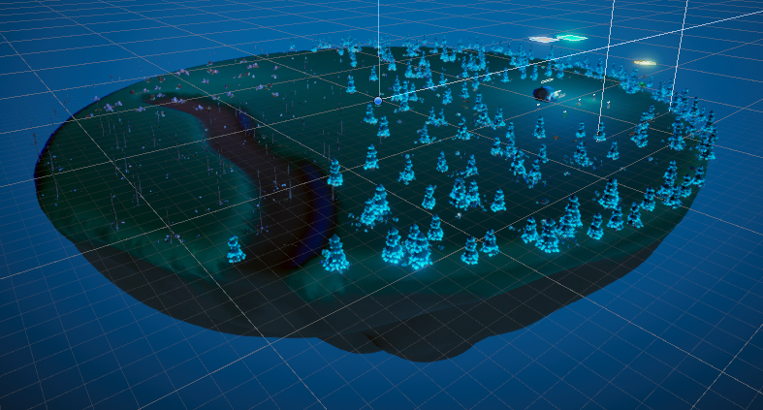
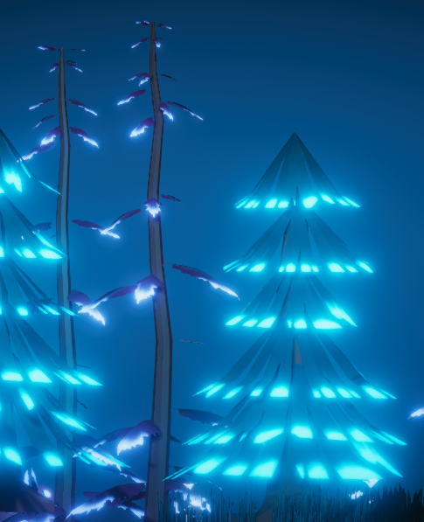
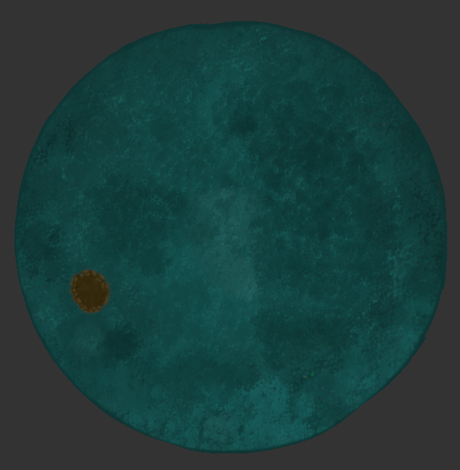
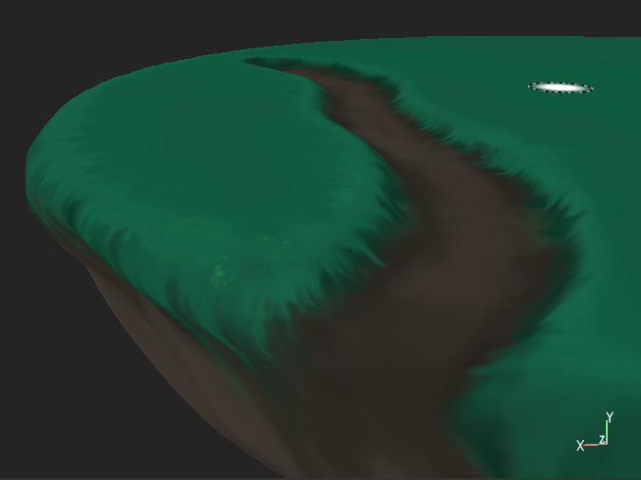
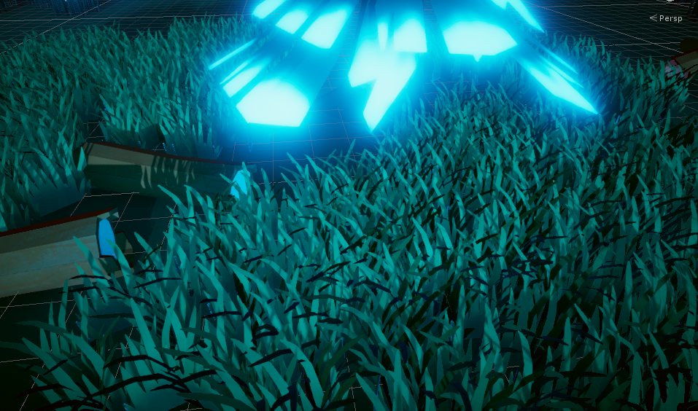
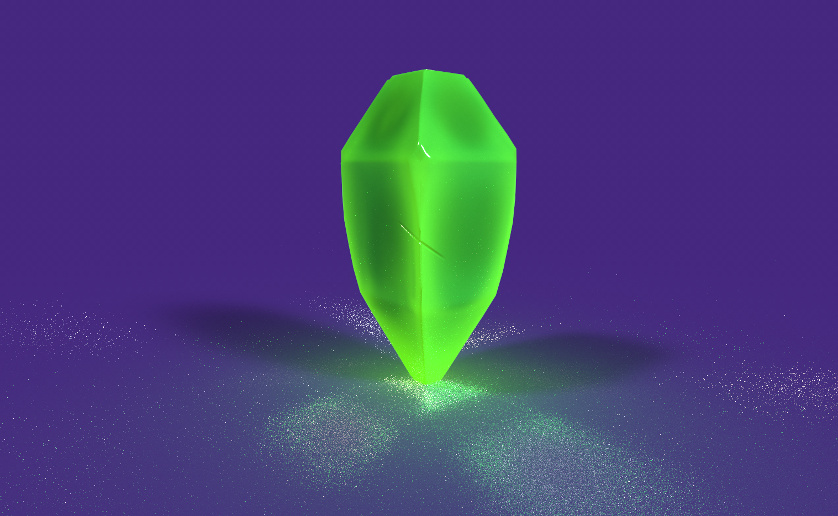
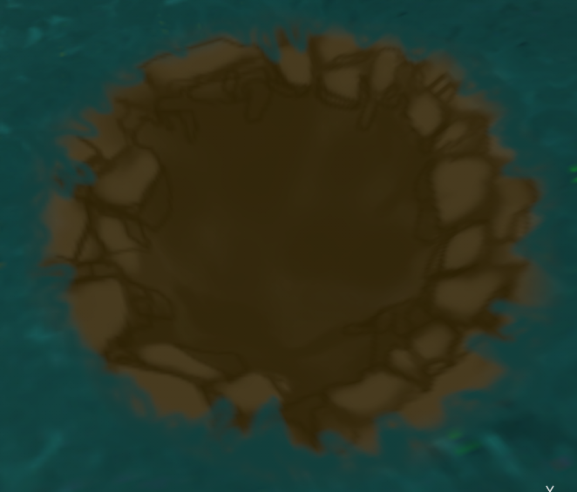
Environment Assets Design
· Plants
· Trees
· Rocks
· Grass
· Floating Island
· New Geiger Crystal

Slide 8
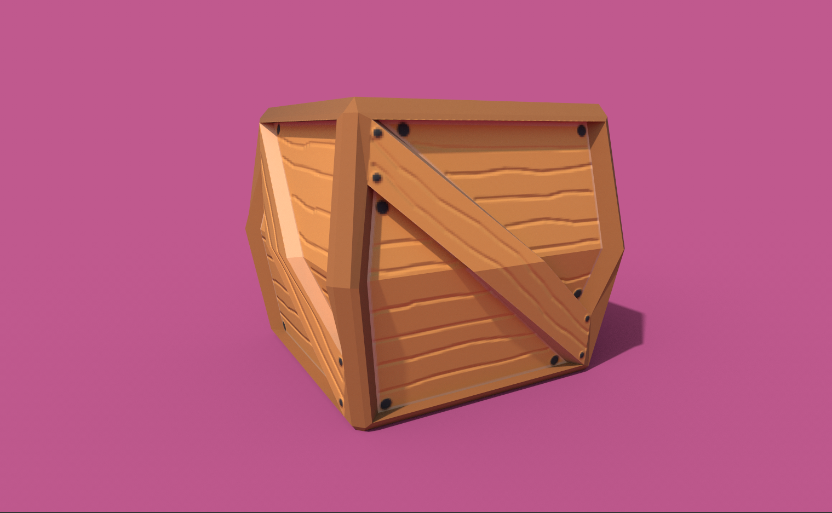
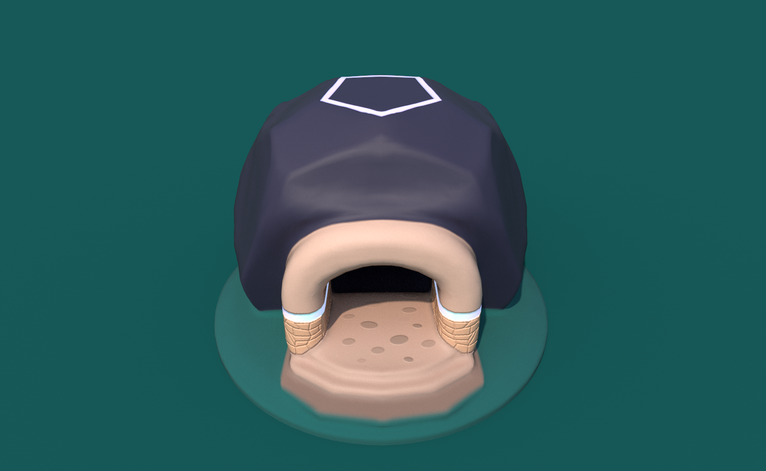
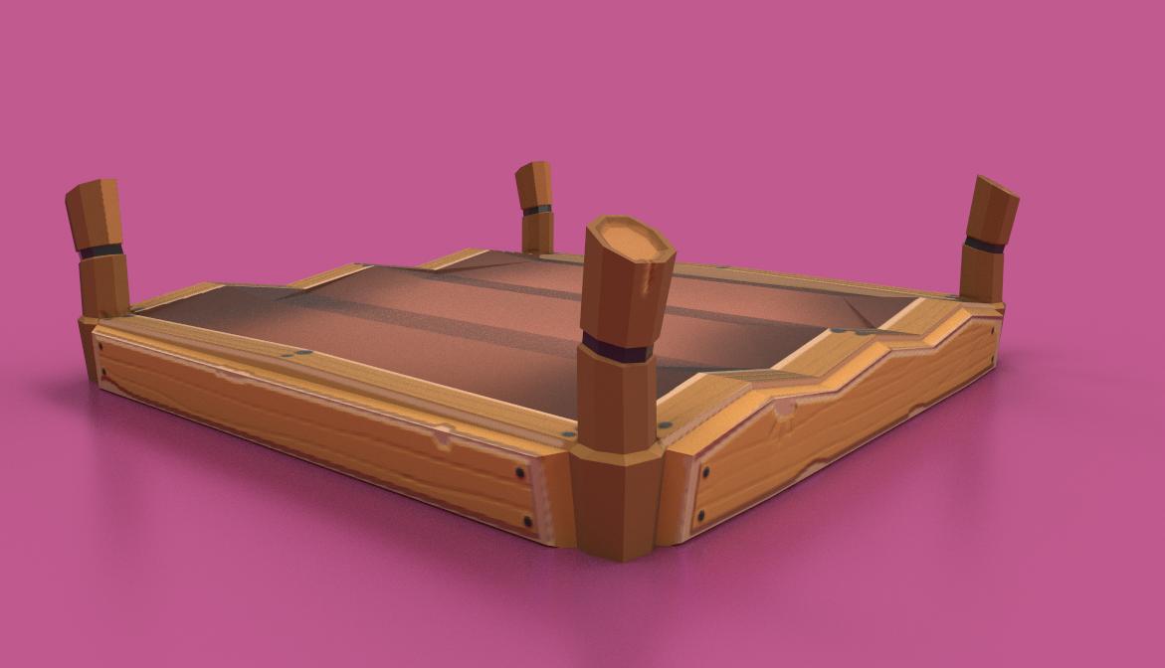
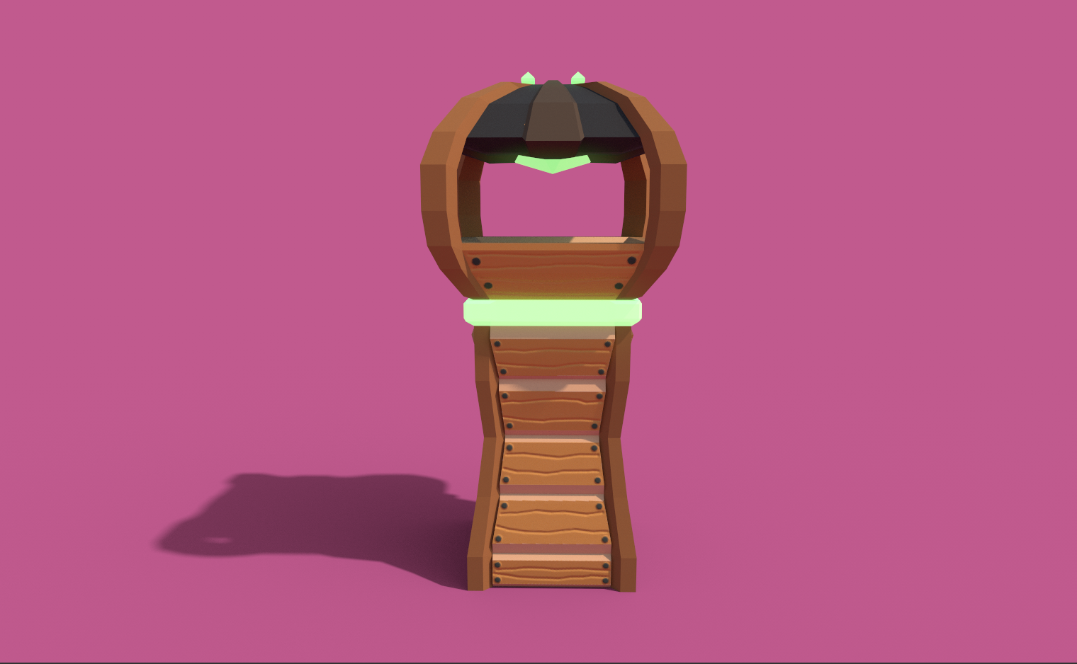
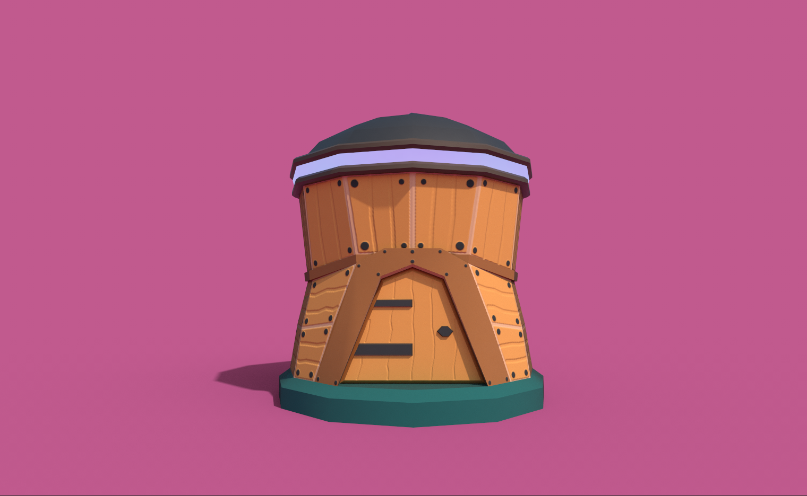
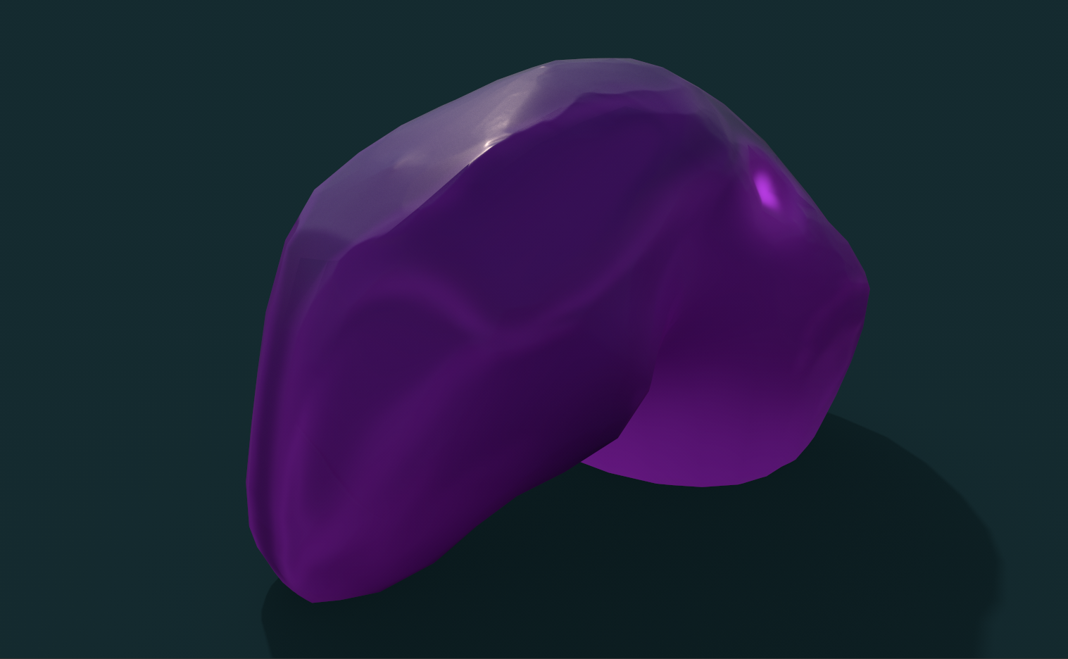
Building Redesign
· House
· Main Base
· Farm
· Wonder
· Tower
· Storage

Slide 9
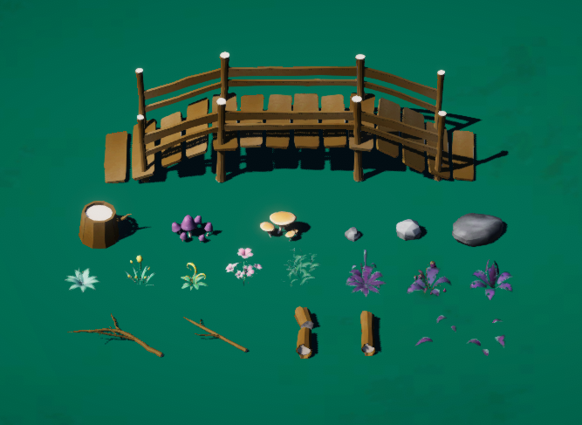
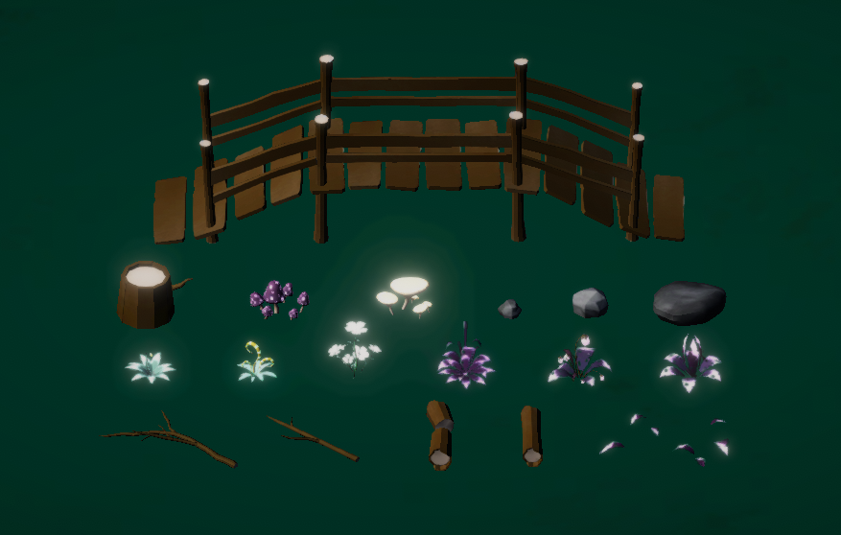
Textures & Materials
· Emissive maps for the nighttime scene.
· Daytime
· Nighttime

Slide 10
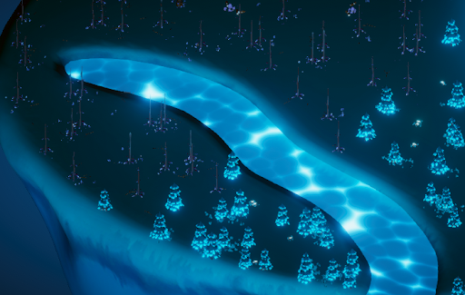
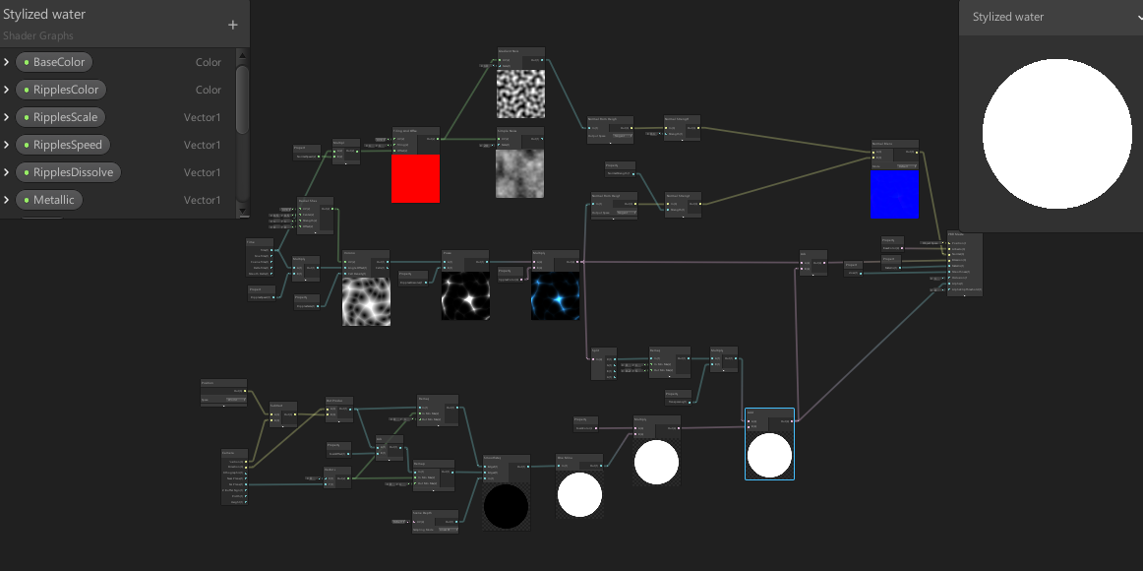
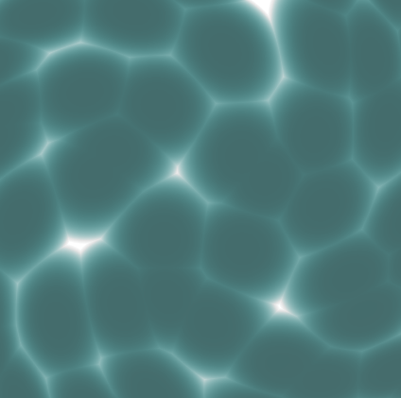
Textures & Materials
· New water material.

Slide 11
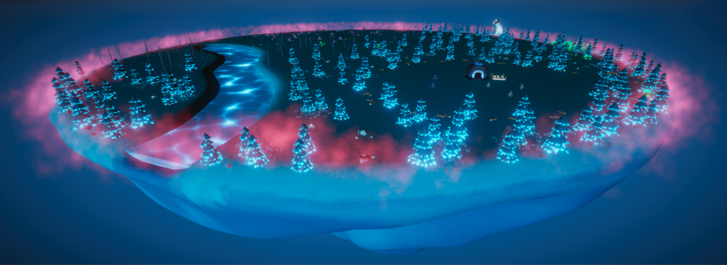
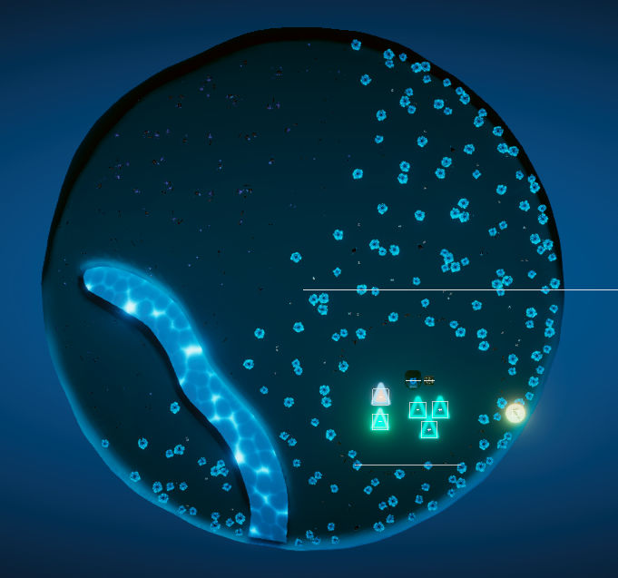
Game Environment Design
· New game environment layout
In order to clearly distinguish between different areas, different kinds of plants will only appear in one area. The objects of the corruption biome environmental props can be similar to other areas, however the objects need to be seen as corrupted. The corruption biome area represents dead.

Slide 12
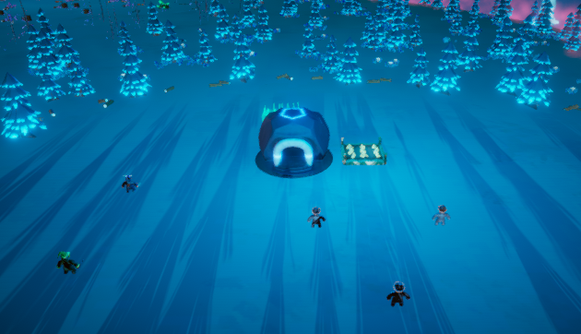
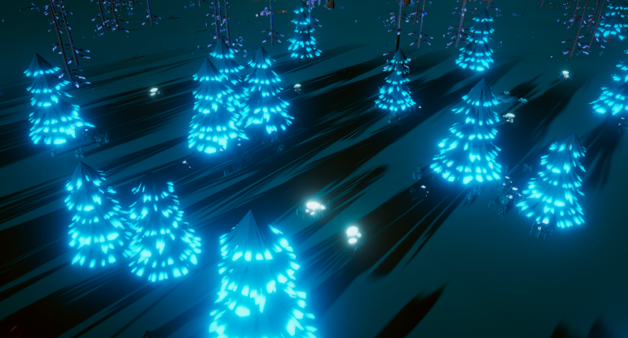
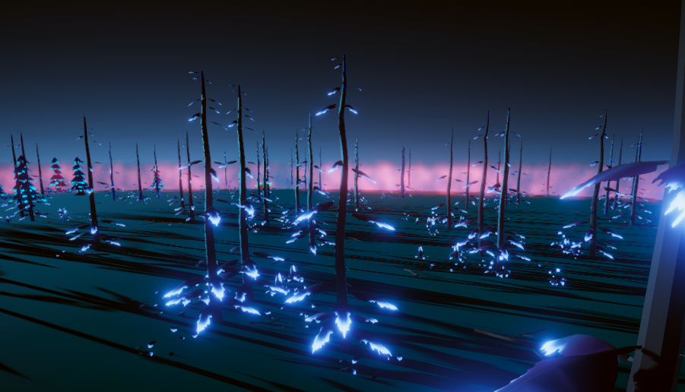
Game Environment Design
· Added night time lighting
· New buildings

Slide 13
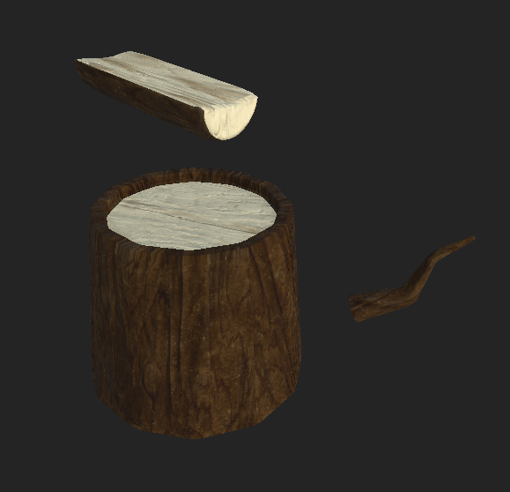
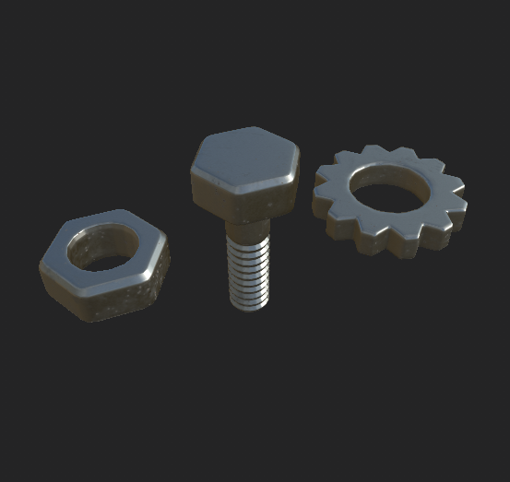
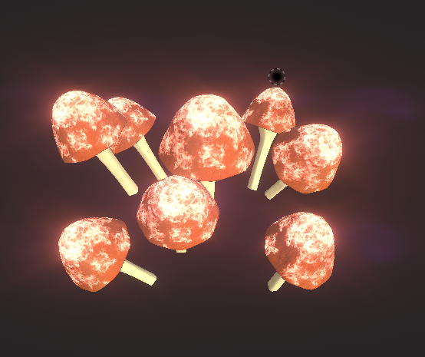
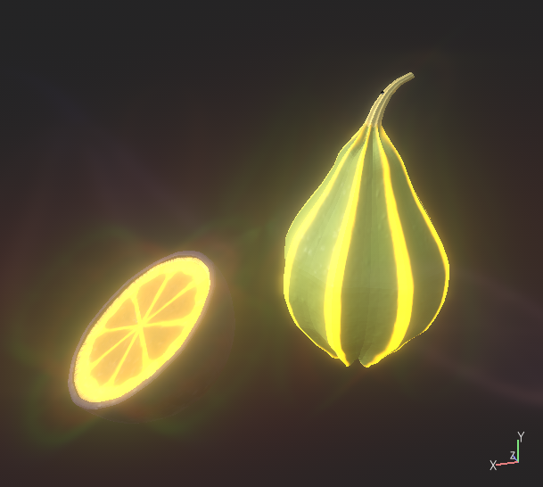
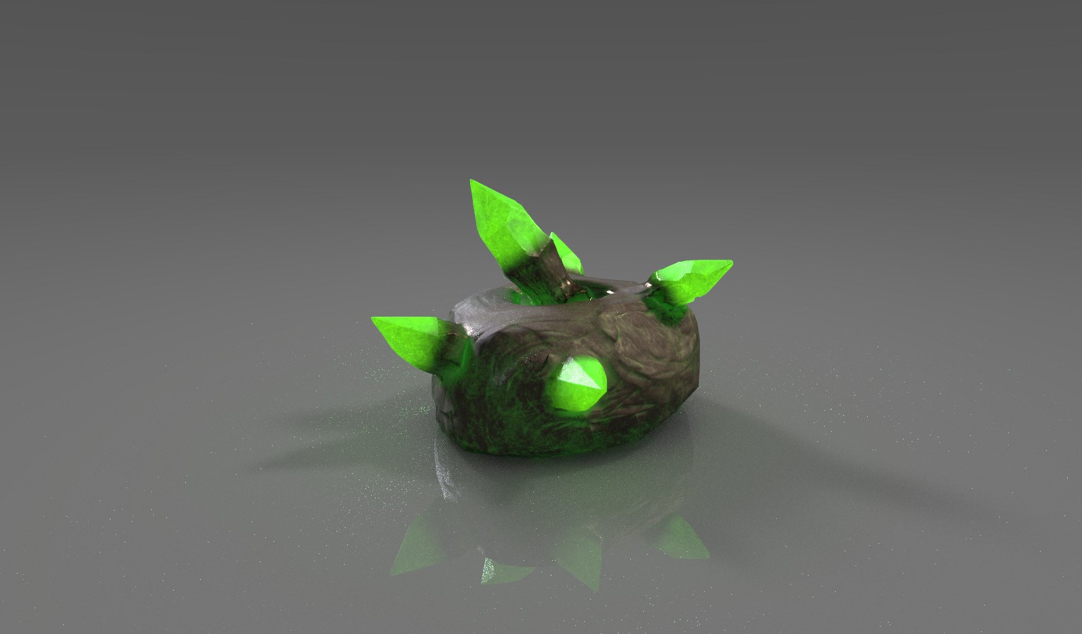
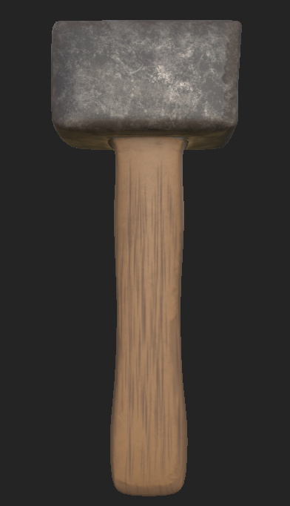
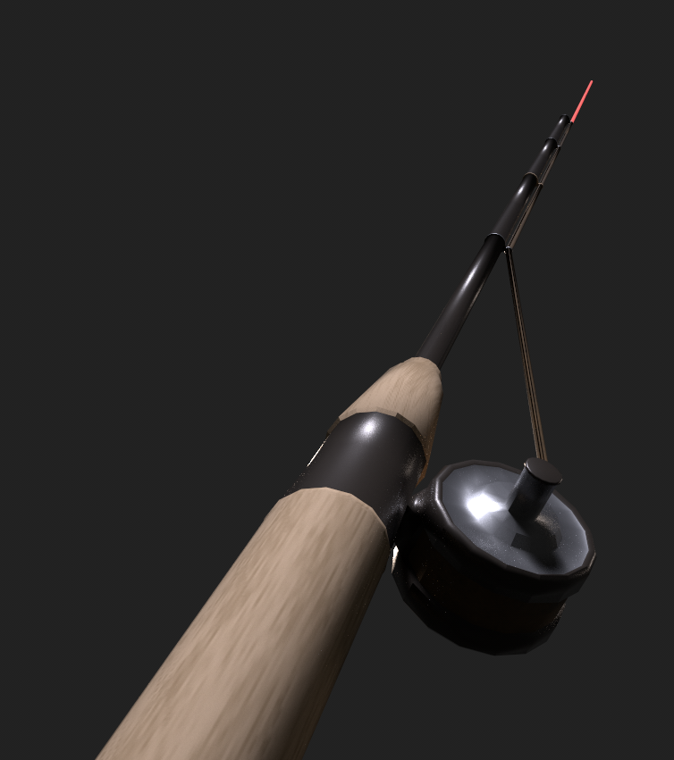
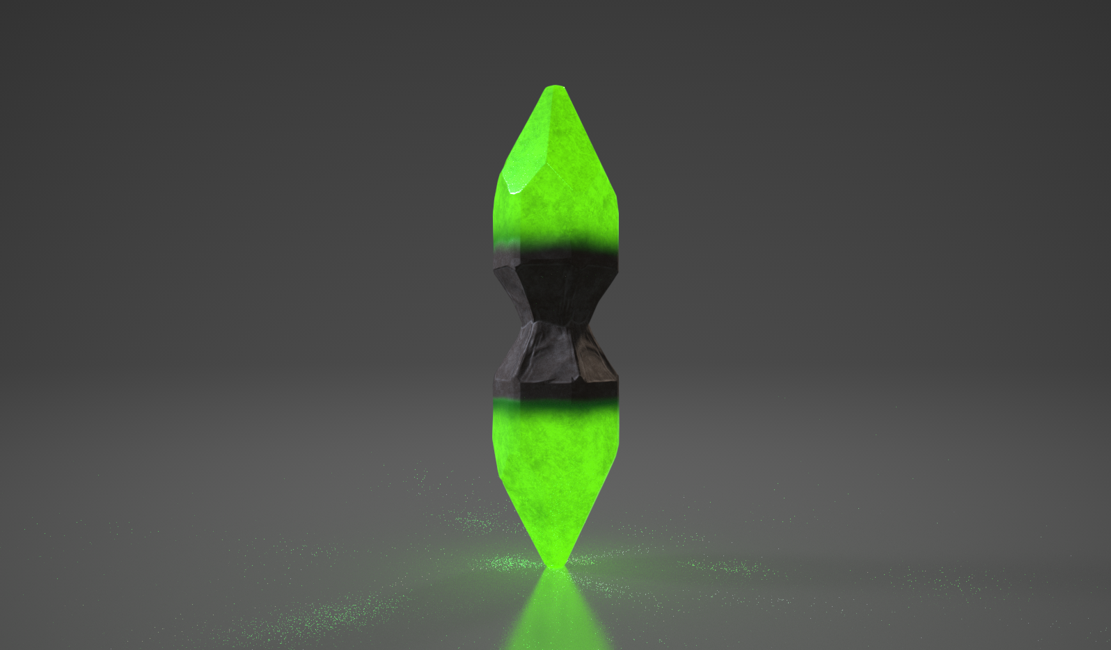
Resource Assets Design
Wongles can be sent to collect resources
· Wood
· Metal
· Mushroom
· Food
· Geiger Strain (From crystal nodes)
· Hammer
· Fishing Rod

Slide 14
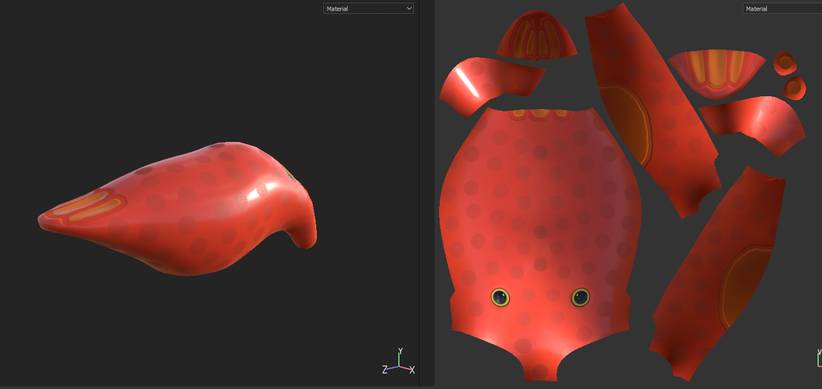
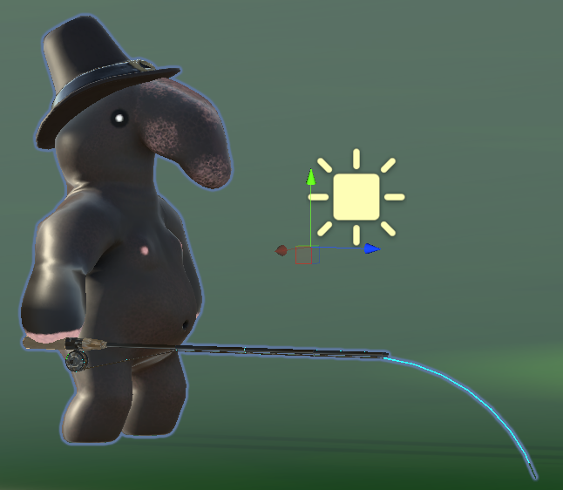
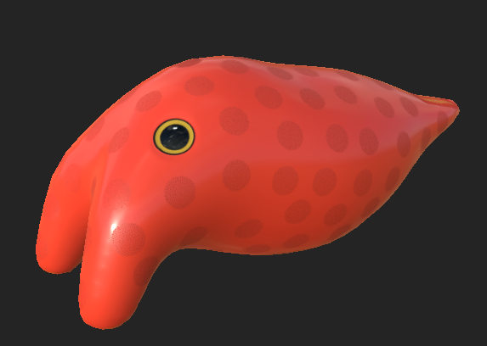
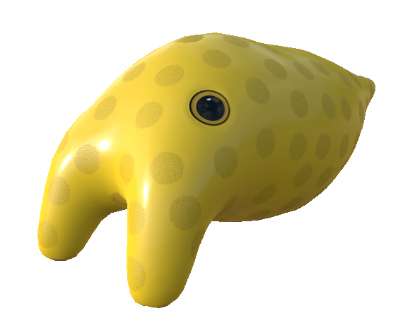
Fishing Object Design
A creature that can be pulled out of the water and carried back to base, representing collected food via fishing.

Slide 15





Tool/Hat Design
Created to represent different roles/tasks between units
· Woodcutting
· Mining
· Farming (Gathering)
· Patrolling
· Attacking (Melee/Ranged)
· Evidence of the research/upgrade system
· Emission/Silhouette helps distinguish units/tasks at night
· Fishing Hat

Slide 16





Character Moodboard Reference

Slide 17
Characters Design
The Wongles are the main player units. They are a colony of weird looking humanoid creatures with big noses. They act as workers. The workers can do many tasks such as mining, chopping wood and farming. The Scrungus and Wizak are both military units that specialize in the defense of the base and the offense against the corruption and its forces. The Scrungus specialize in melee combat and the Wizak in ranged. The Scrungus and Wizak are their own unique species and are not Wongles.
The Mushroom Friends are the forces of the corruption. They are humanoid mushroom based creatures that crawl across the ground with the sheer strength of their upper bodies. There are two types of Mushroom creatures, the Brood-Shrooms and the Fiends. The Brood-Shrooms are the elders/leaders of the corruption forces. The Fiends are the main grunt force of the corruption. They are quick and ferocious and lay waste to anything they come across, and they are spawned by the BroodShrooms which act like a mobile base for the enemy forces.
The Junger Slunk is a new enemy unit born from the Brood-Shroom but with a different purpose to the Mushroom Friends; this unit will fix itself to the ground at a safe distance and fire projectiles at the players base. They are shy however, and will be unwilling to attack your player units, preferring solidarity and to stay a safe distance away from combat.

Slide 18



Wongle Character Process
Designed to be cute, visually distinct to the game
· Unit variations expressed through tool usage/hats
· Original design inspired by psychedelic art
· Adapted to a fantasy setting
· New animations created for task variety

Slide 19


Art Rework: New Wongle Design
· A new default texture for the Wongle Worker.
This task features the first batch of the art overhaul changes. Going forward each major art asset will receive new textures more closely affiliated with our new moodboard, heavily consisting of reference to the Spyro Remastered Trilogy.

Slide 20



Mushroom Character Remastering
Designed to be hulking, visually intimidating compared to wongles
· Created to overwhelm defenses
· Follow a unified red/cream color theme for identification purposes
· Greater tonality, cleaned up normal maps

Slide 21




Unification of Military Unit Art
· War Scrungus
· Wizard
The new military units have been redesigned to fit the stylized look of the remastered Wongle unit.

Slide 22



Junger Slunk Remaster
· The Junger Slunk
This unit is being developed from the tutor feedback that our enemies need more combative depth, in order to expand the complexity of the combat phases to a reasonable extent, giving players a broader range of considerations when they defend their base.
The Junger Slunk will attack buildings from a distance, making bases more vulnerable, but it will not attack player units.

Slide 23

The Blonk (Scout Unit)
· The Blonk
This unit is being developed from the tutor feedback that unit functionality should be split between more units to increase strategic utility.
This unit while fragile in combat, will run exceedingly fast, acting as a disposable reconnaissance unit which can quickly reveal enemies and crystal nodes with more efficiency than any other unit.

Slide 24







Menu Design
Menu Reference
Old
New
· Fantasy feeling
· Only one main color for the main menu(White)
· Use yellow out glow to make the UI more clear
· Option button should be really clear
· Setting
(Master, Music, Sound Fx, Resolution, Screen Size)
· Play
· Exit

Slide 25



UI Design
Old
New
Color choice
· White for text
· Grey for background
Art style
· Fantasy
· Fit the vein of Alice in Wonderland and Avatar
The intent is to modify the UI to improve overall readability, and the usage of space. This may lead to the generation of some extra UI assets but this isn't the intent initially.
Latest

Slide 26






Minimap Icons
Developed a series of minimap icons to represent key resources, and player/enemy units.
Before there were simply a series of large squares that did a poor job of communicating the number of units a player had, and did not clearly highlight mining points of interest, nor distinguish different units (including the enemy) from one another.
These icons are a first pass at improving this.

Slide 27









VFX Design (Particles Effects)
· Waterfall
· Projectile
· Placed building
· Building explosion
· Enemy obscuring
· Farmed resources
· Leaves and butterflies for daytime scene
· Fog, fire and fireflies for nighttime scene

